Slide 1


Guide: Dr. Arindam Dey
Zynofus Technologies Private Limited
PATIENT DATA ANALYTICS BY TERM FREQUENCY MODULATION DIAGNOSIS
REVIEW- 3
Presented by: Shaik Mohammad Waseem

Slide 2

INTRODUCTION
In the realm of modern healthcare, the exponential growth of patient data poses significant challenges and opportunities. Leveraging term frequency modulation, we aim to extract nuanced patterns from vast electronic health records (EHRs) to enhance diagnostic accuracy. This technique transcends conventional keyword searches, considering contextual relationships between terms to identify disease-related patterns. By emphasizing relevant terms and minimizing noise, term frequency modulation promises to streamline healthcare delivery by providing clinicians with timely insights for early detection and personalized care.

Slide 3
MODULES
EMR
ETIOLOGY
DIAGNOSIS
DECISION SUPPORT
ADMIN

Slide 4

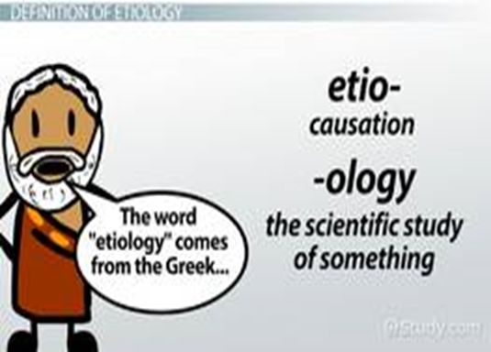
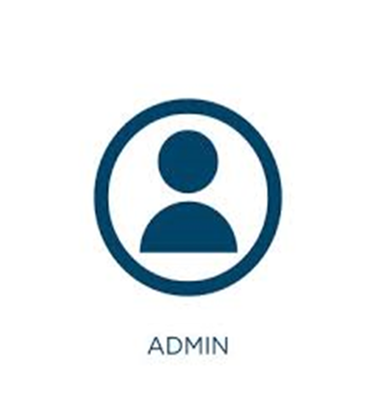
EMR
ETIOLOGY
ADMIN

Slide 5
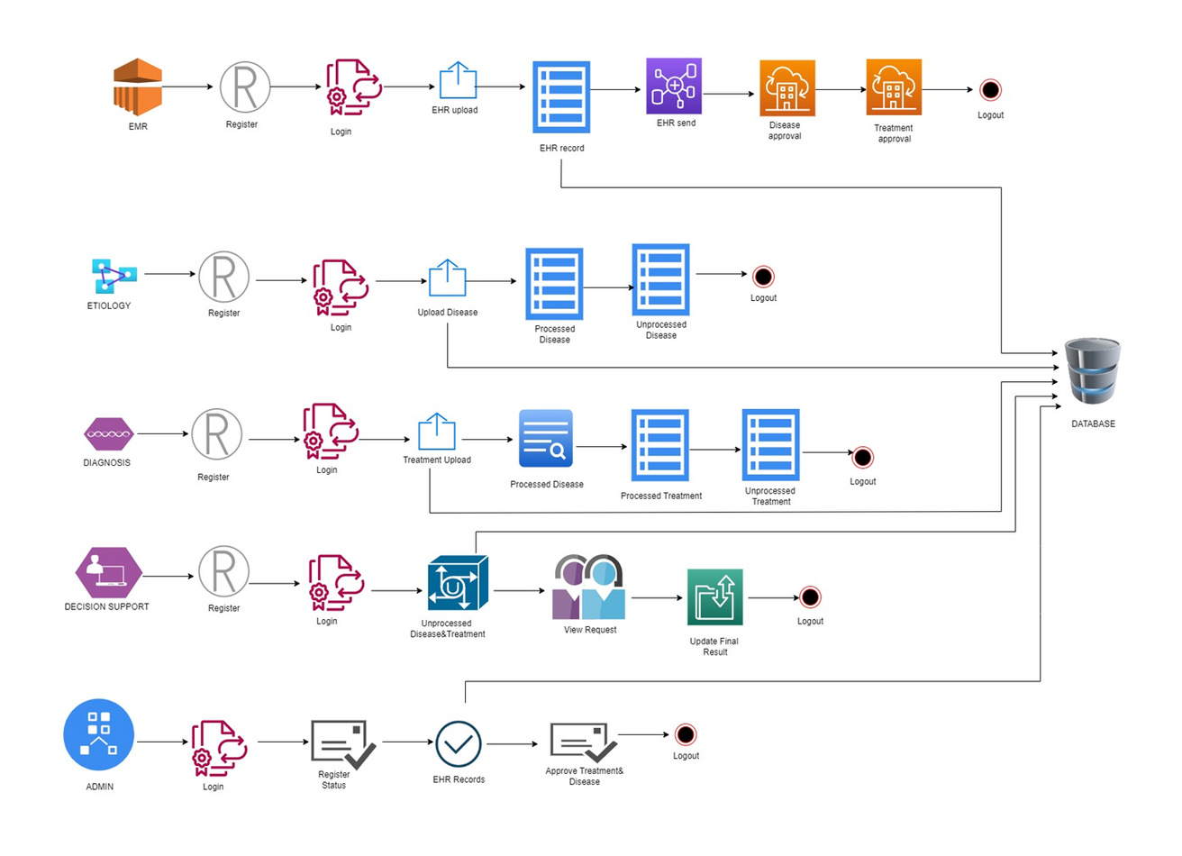
SYSTEM ARCHITECTURE

Slide 6
Software Requirements:-
• Front end : core java, css, js, servlet
• Web application : J2ee Frameworks
• Back end : MySQL 5.1
Algorithms used:-
Cryptographic: SHA256 and Blowfish
ML algorithm: TF-IDF(Term frequency inverse document frequency)

Slide 7
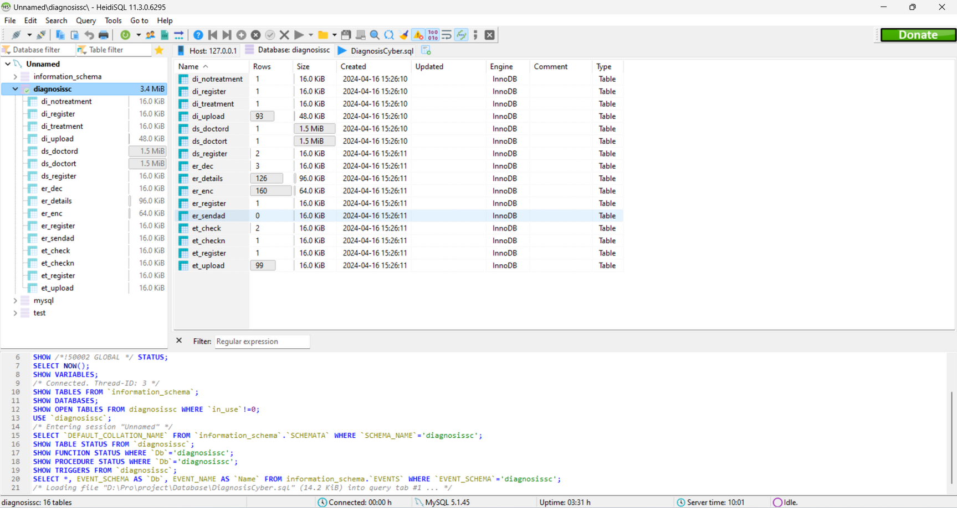
Heidi SQL

Slide 8
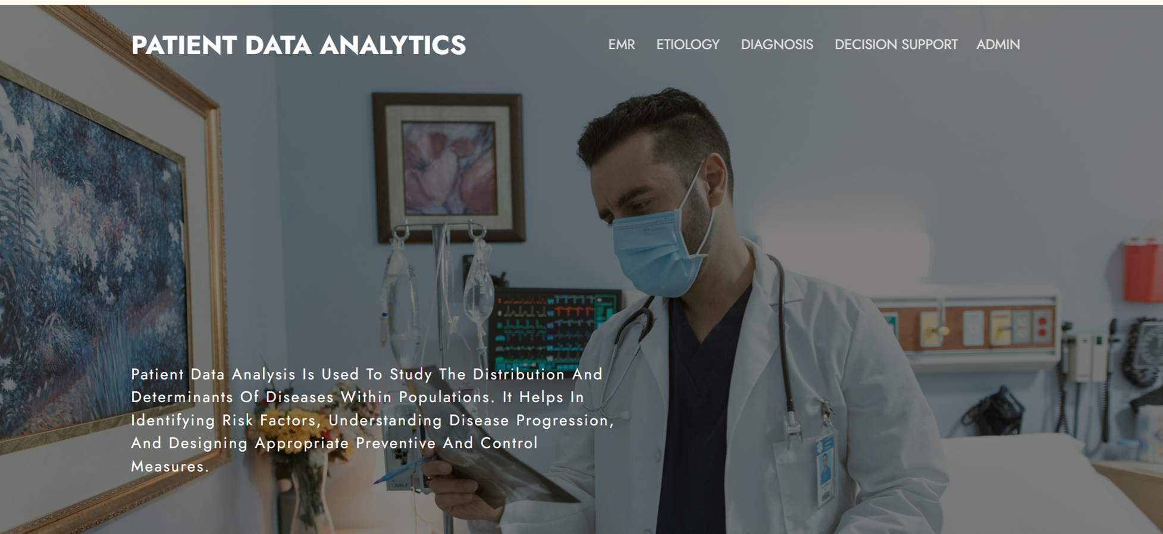
HOME PAGE

Slide 9
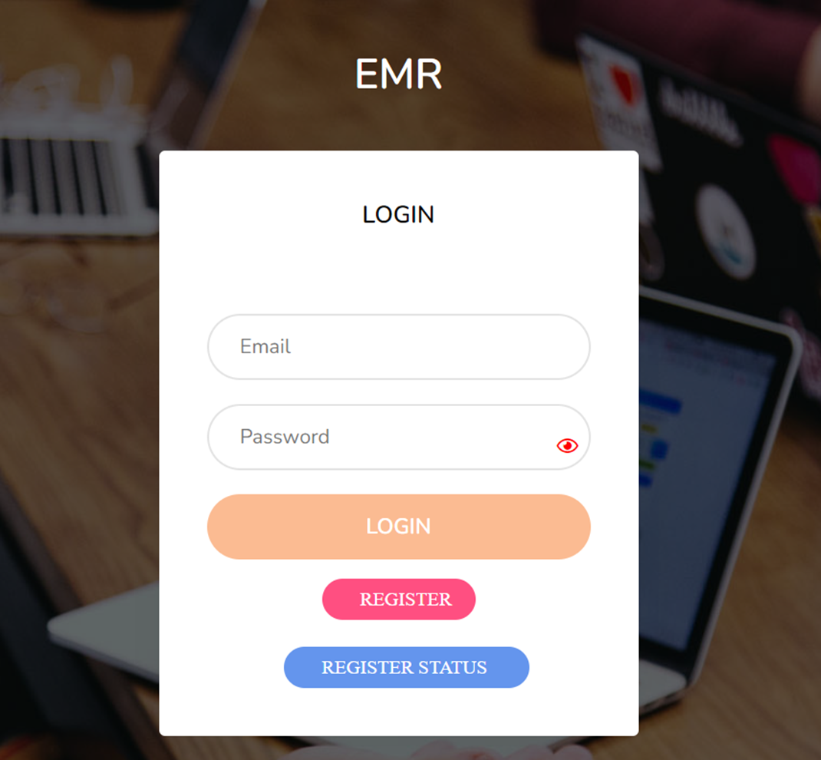
EMR LOGIN PAGE

Slide 10
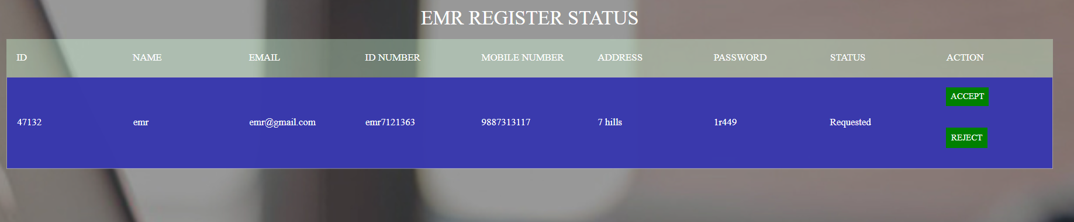
EMR REGISTER STATUS

Slide 11
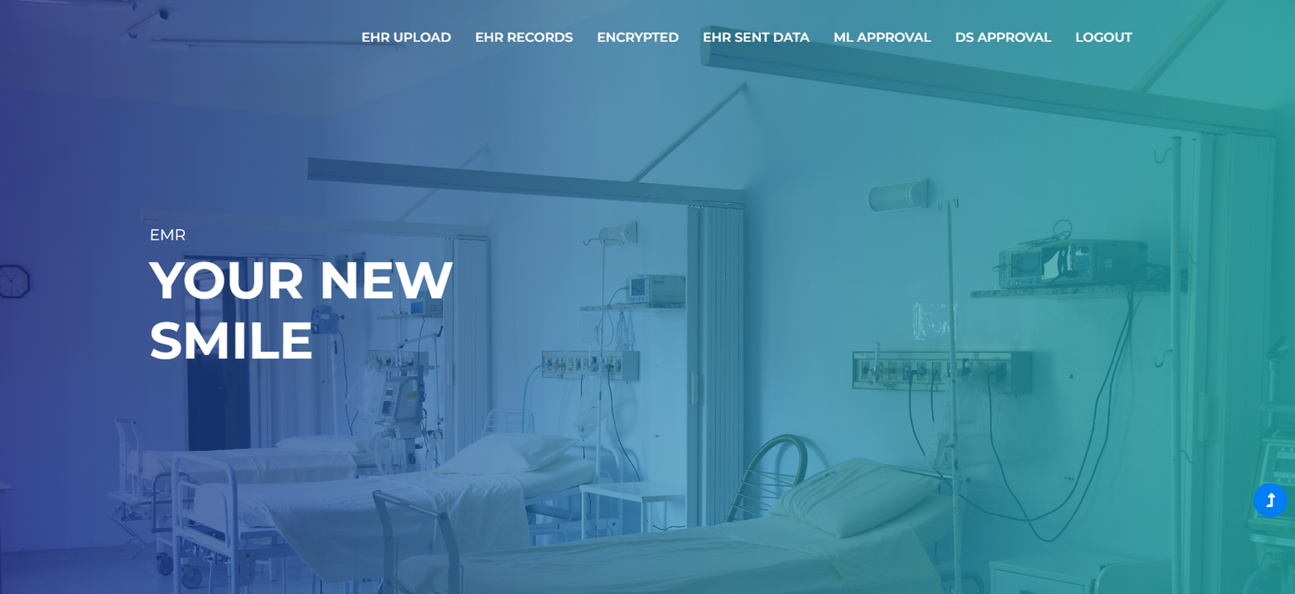
EMR HOME PAGE

Slide 12

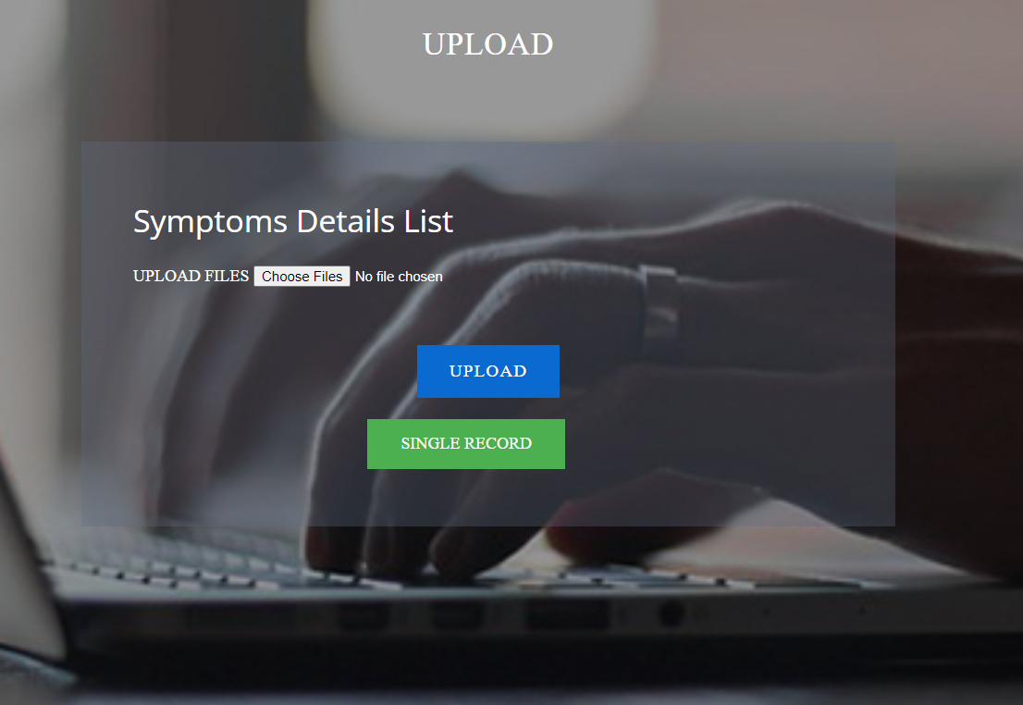

Slide 13
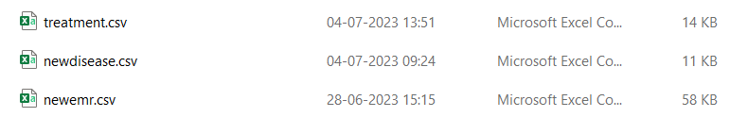
DATASET

Slide 14
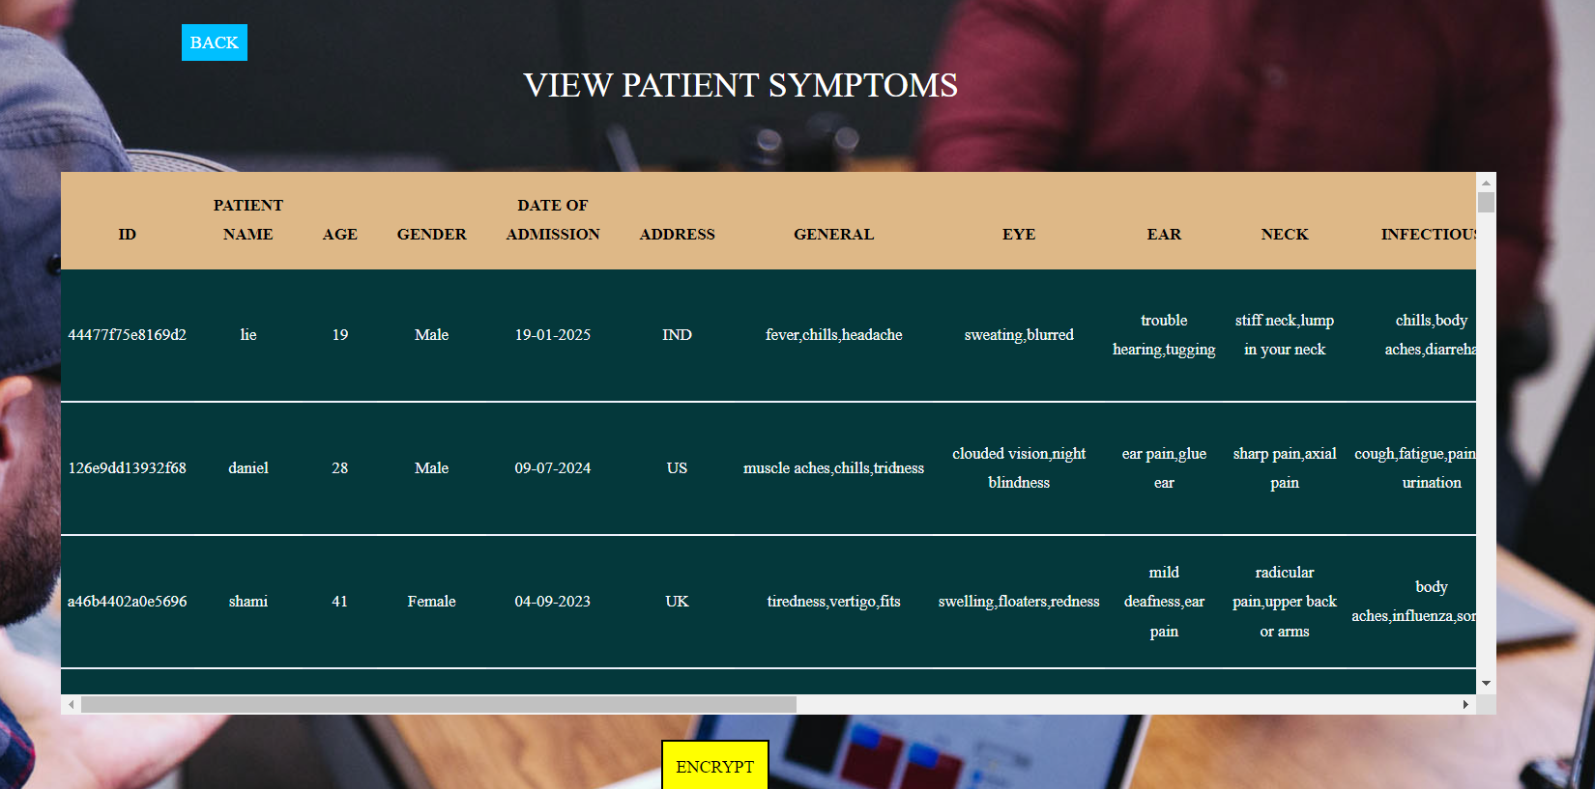

Slide 15
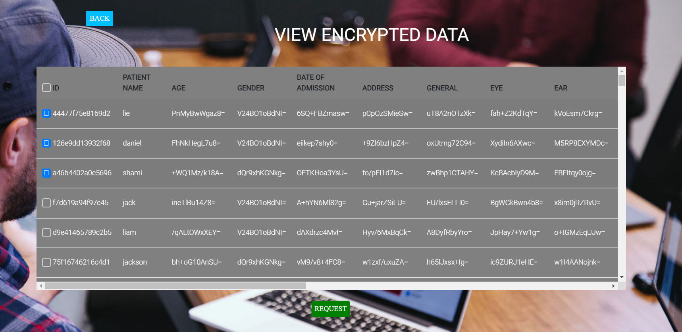
ENCRYPTED DATA

Slide 16

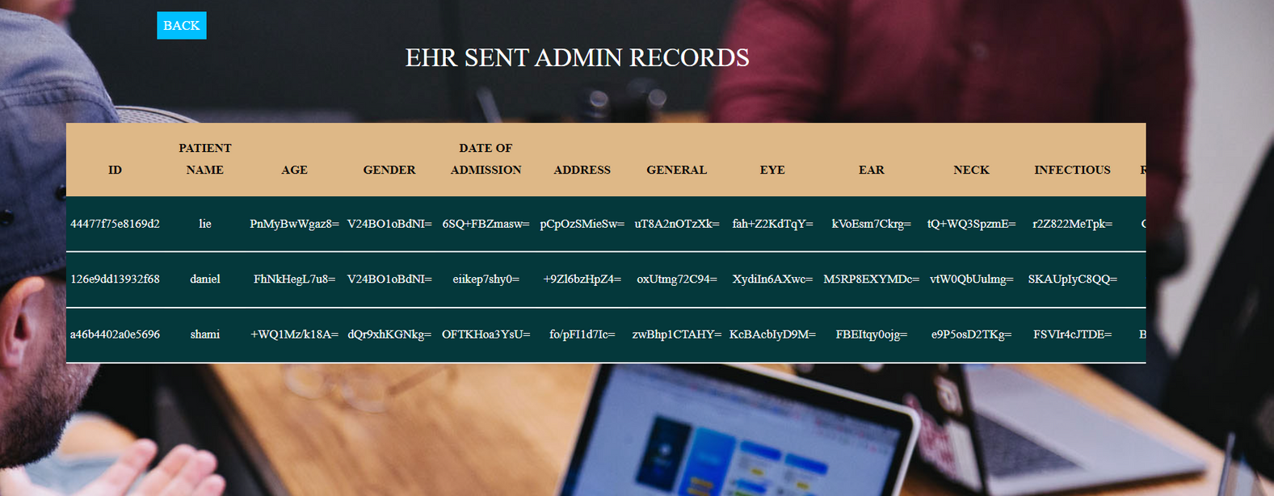

Slide 17
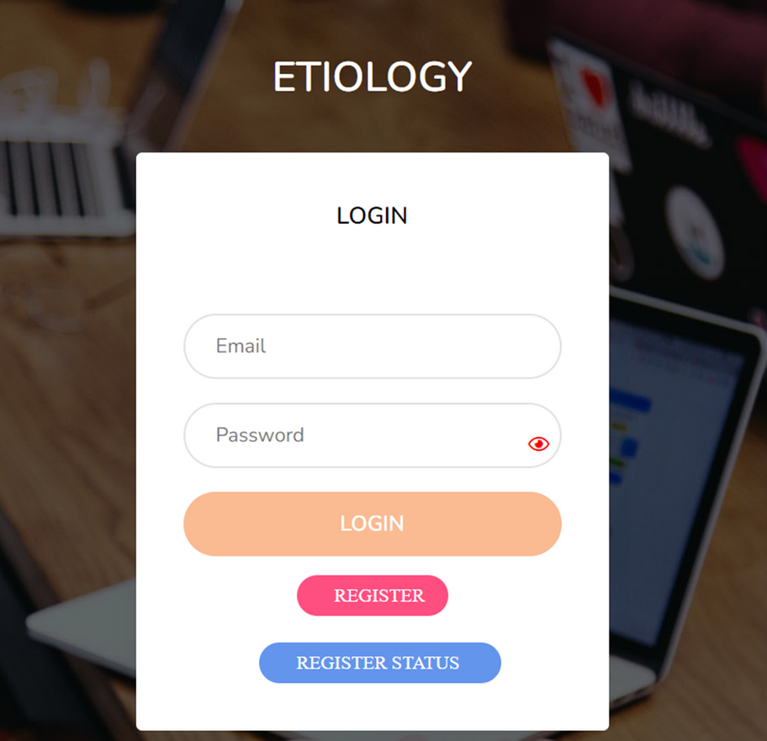
ETIOLOGY LOGIN PAGE

Slide 18
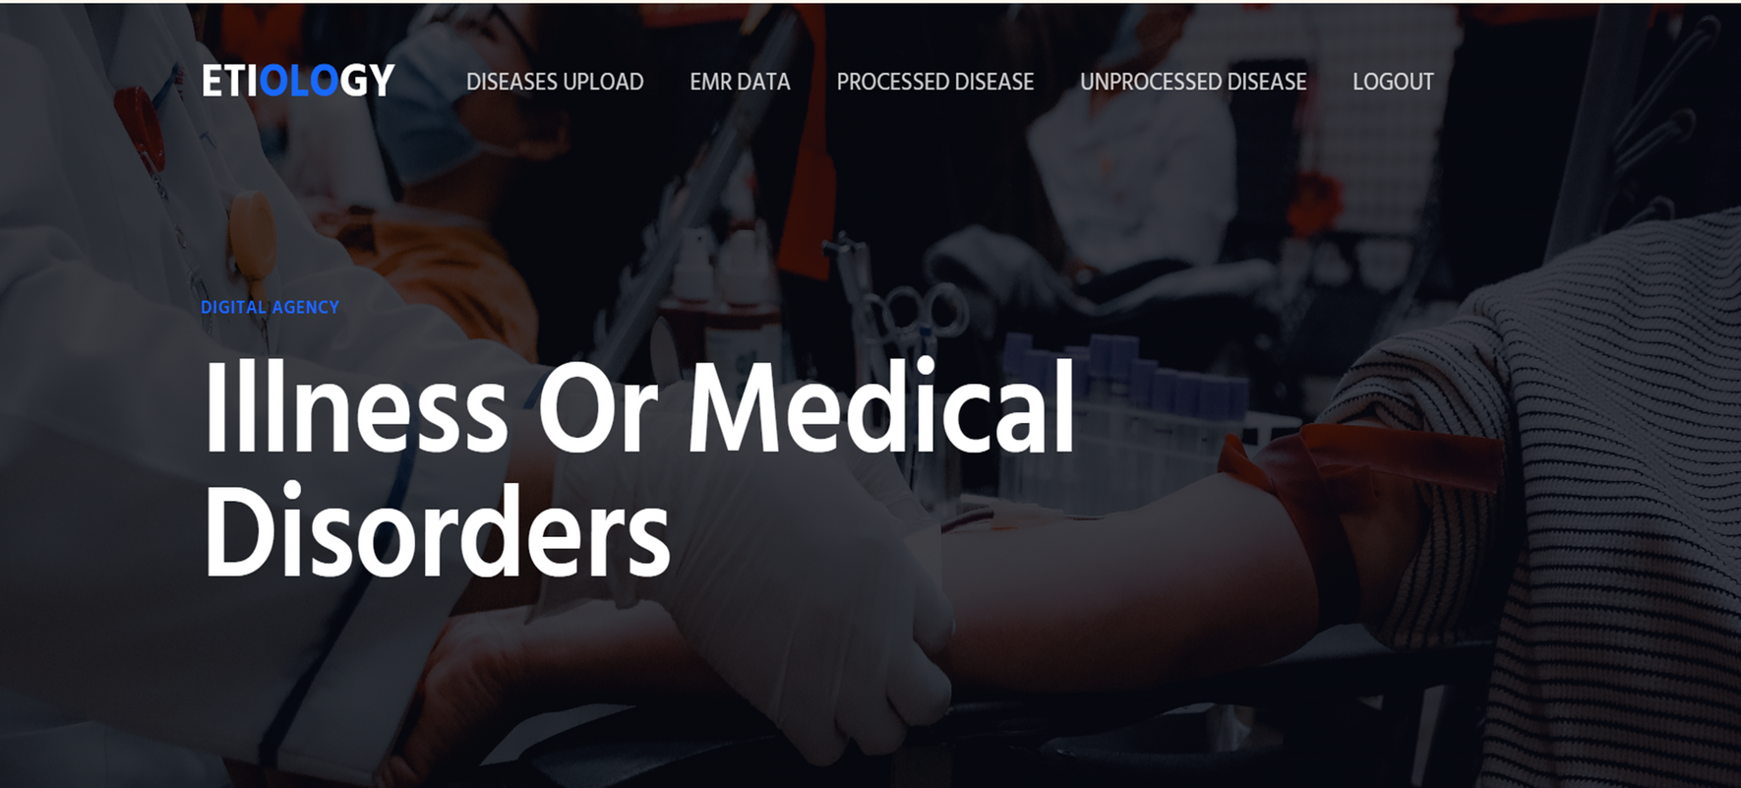
ETIOLOGY HOME PAGE

Slide 19
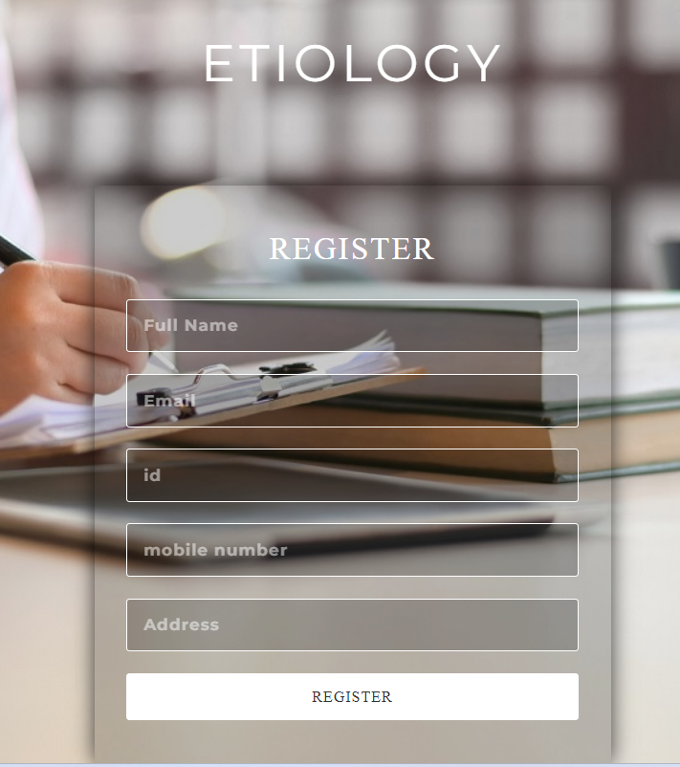
REGISTRATION

Slide 20
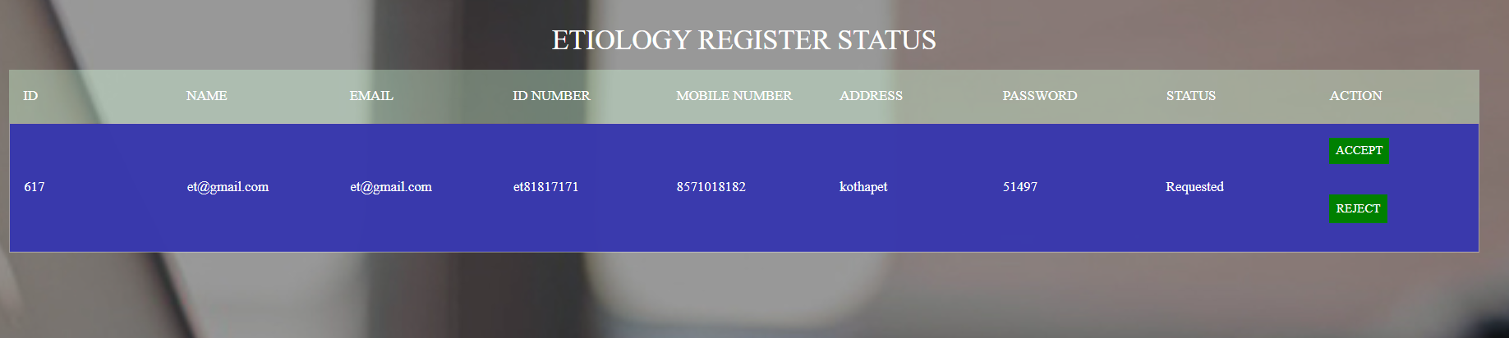
ETIOLOGY REGISTER STATUS

Slide 21
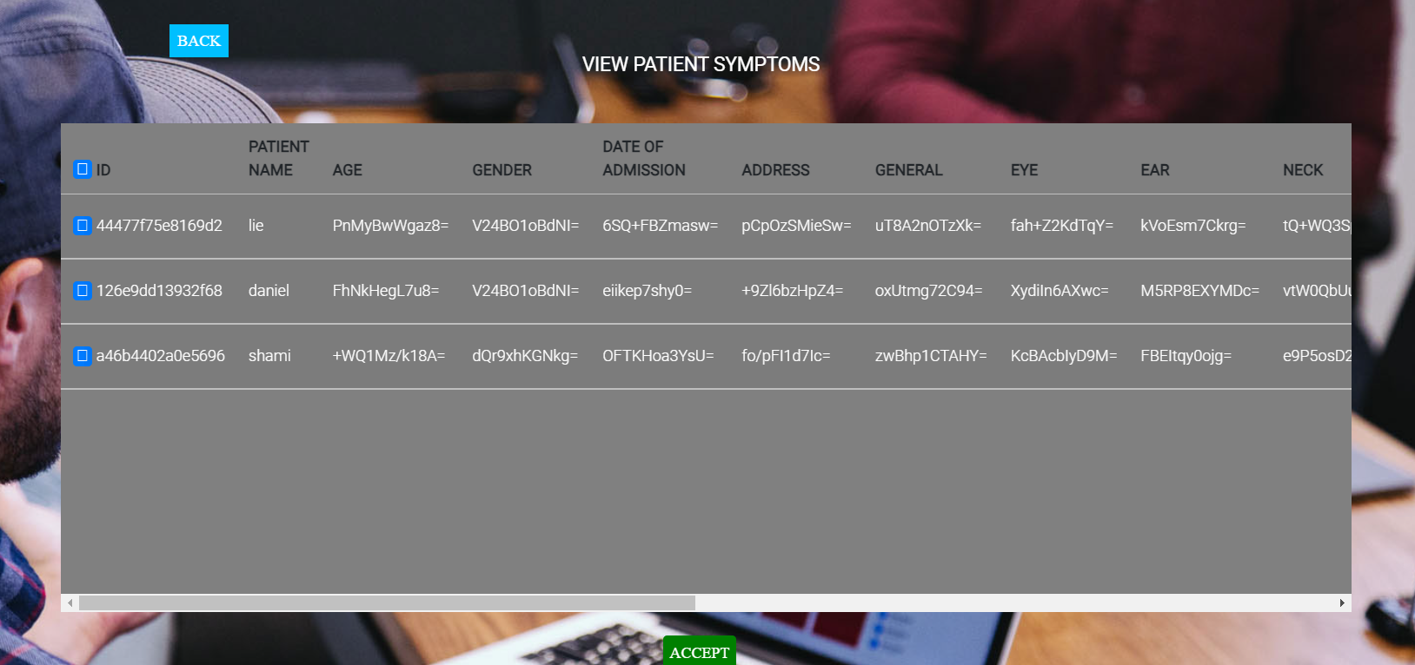
DECRYPTION

Slide 22
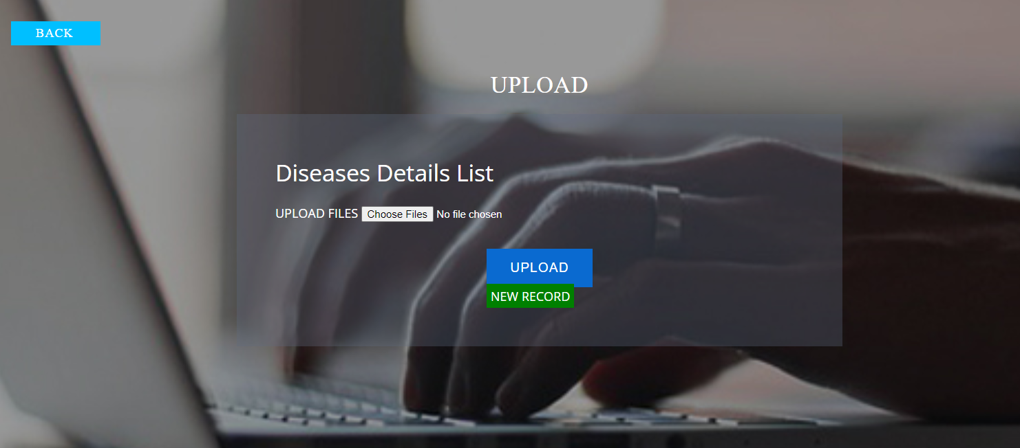

Slide 23
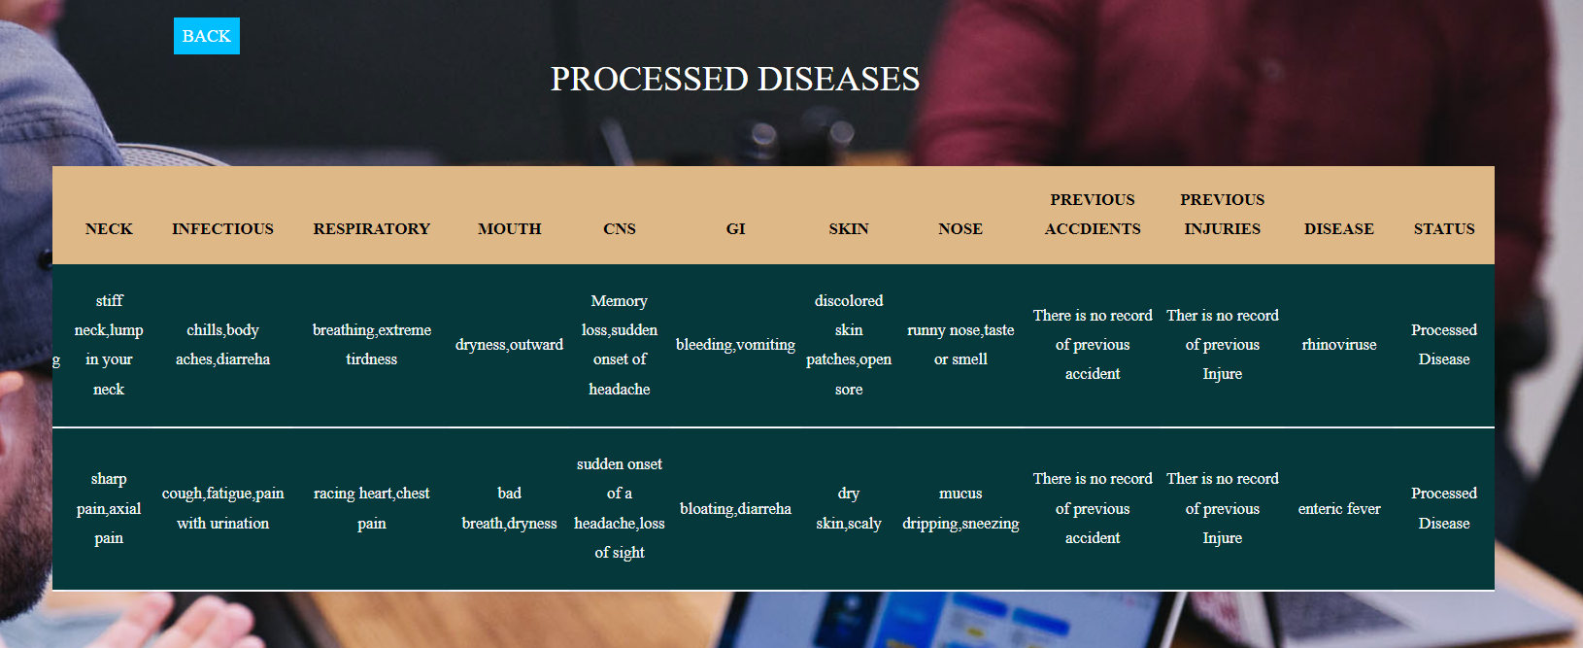
PROCESSED DISEASES

Slide 24
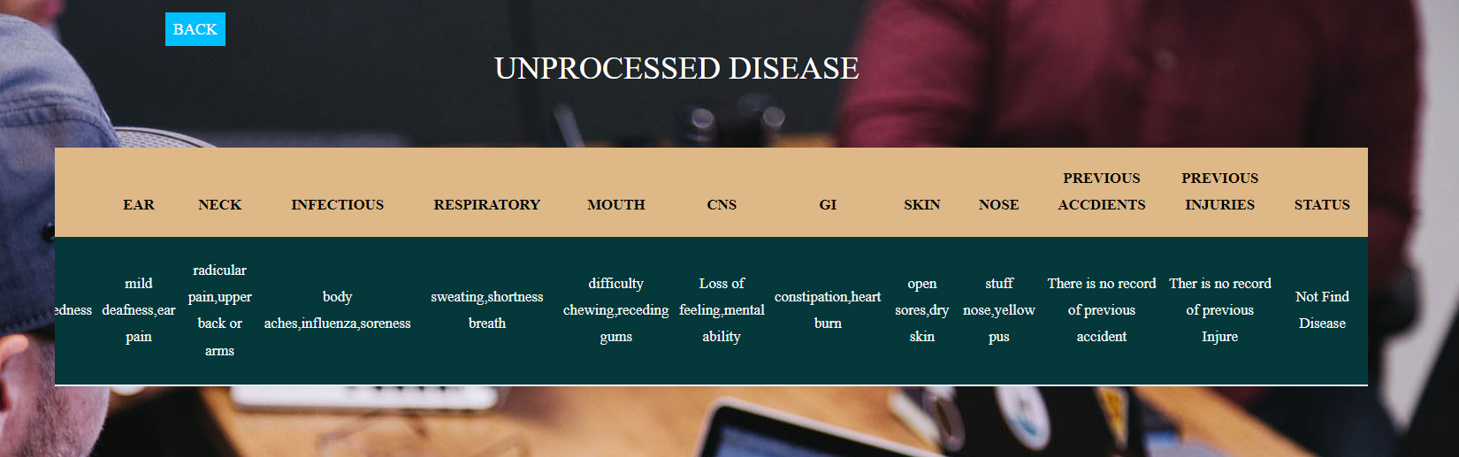
UNPROCESSED DISEASES

Slide 25
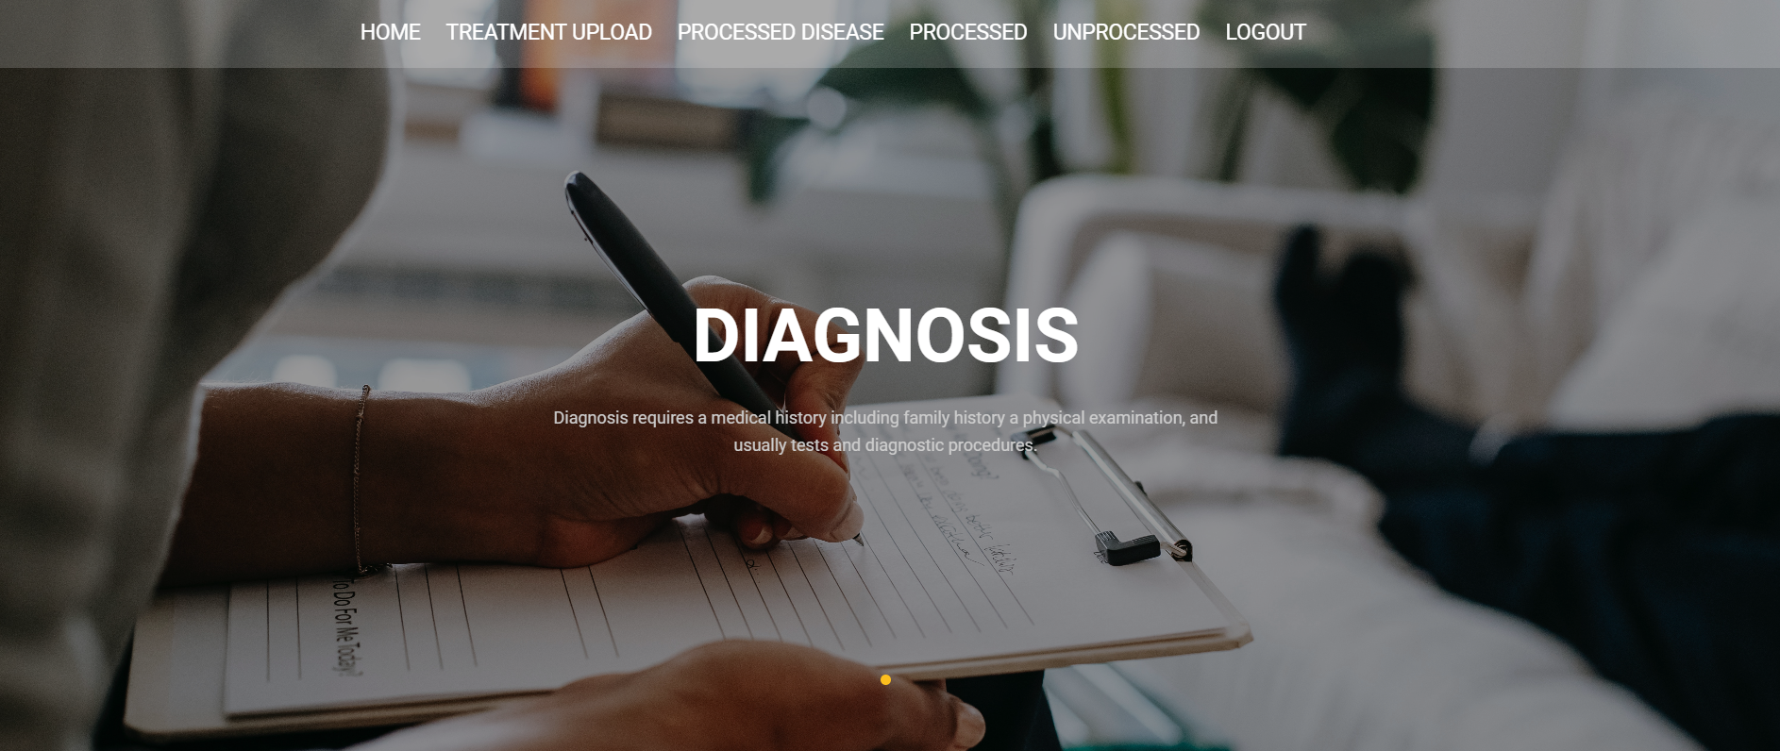
DIAGNOSIS HOME PAGE

Slide 26
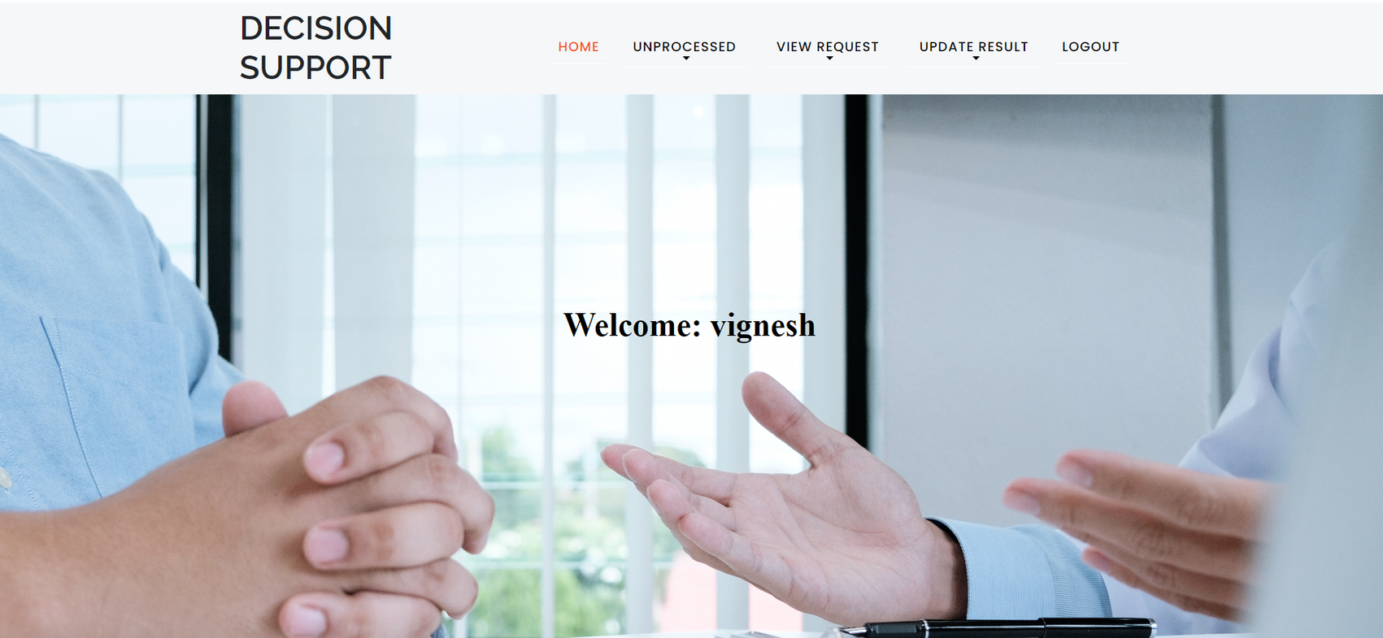
DECISION SUPPORT HOME PAGE

Slide 27
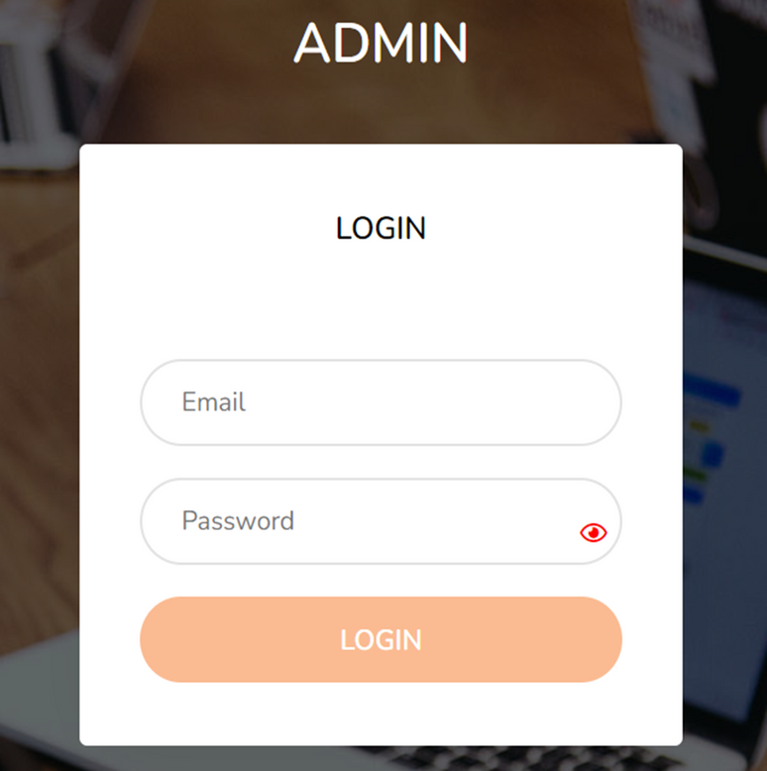
ADMIN LOGIN PAGE

Slide 28
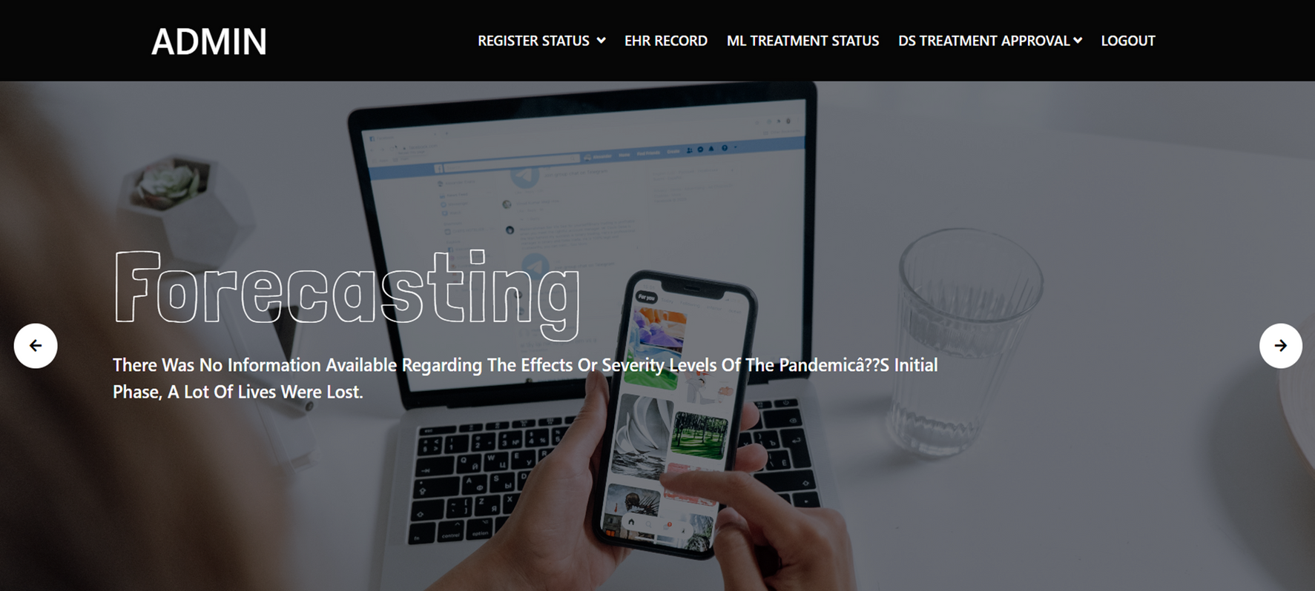
ADMIN HOME PAGE

Slide 29
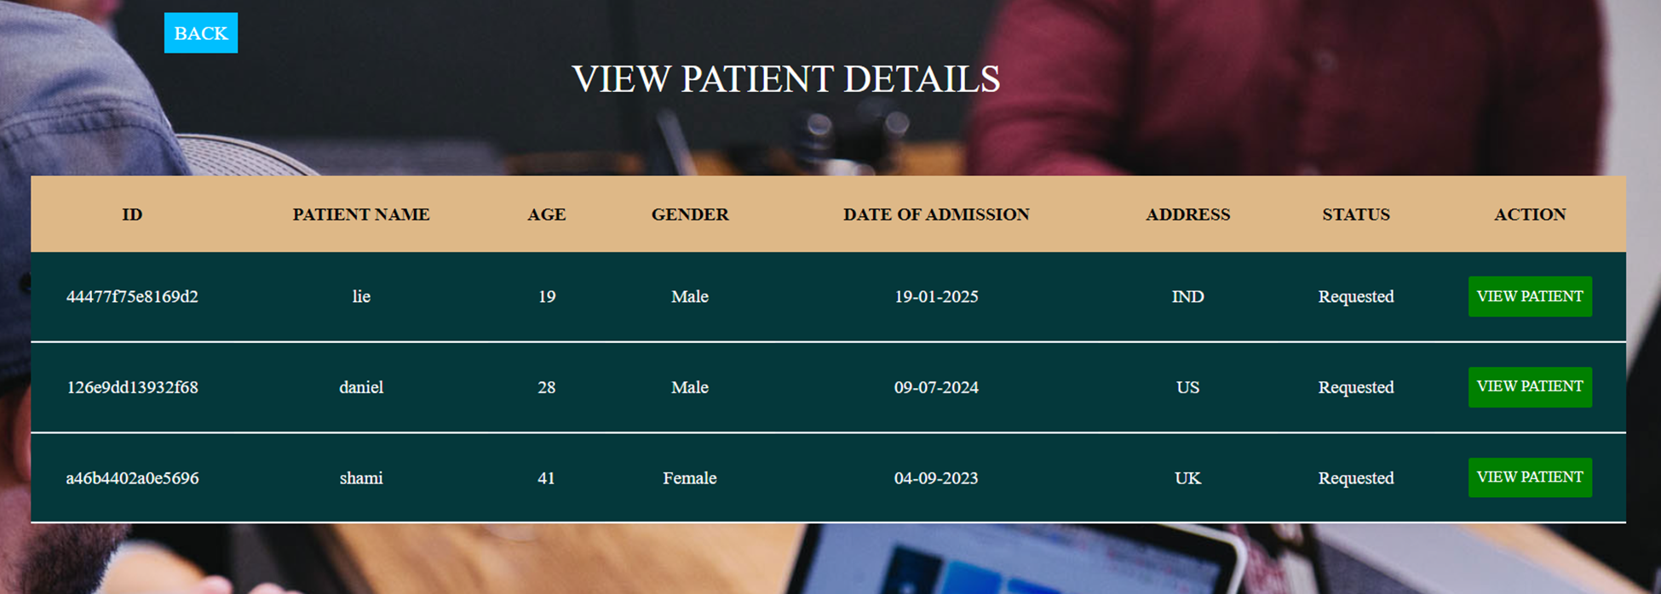
EMR ML APPROVAL

Slide 30
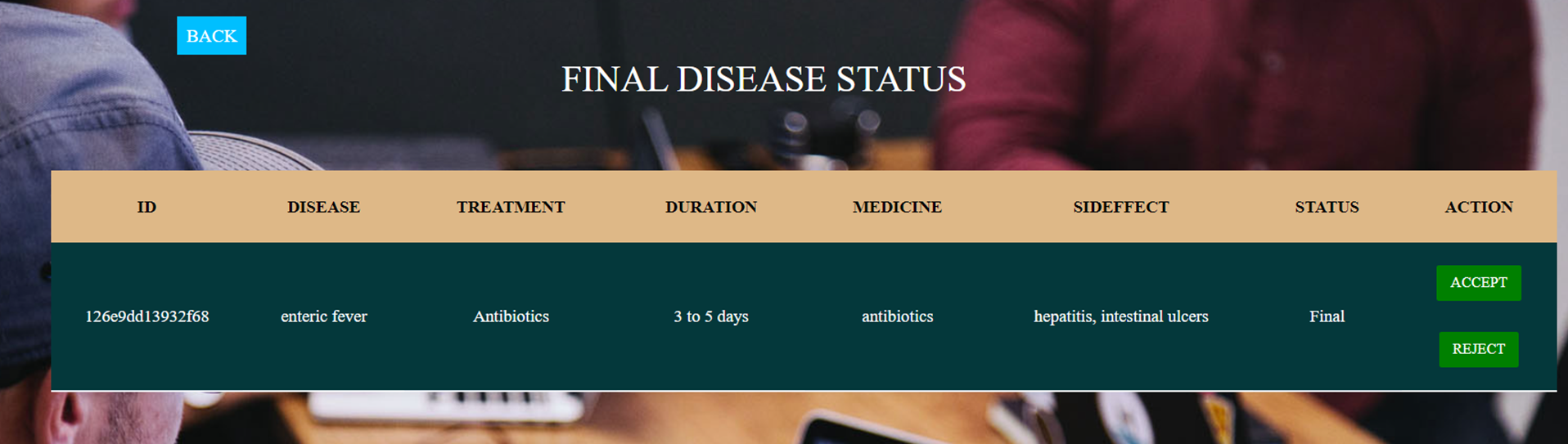
EMR ML FINAL STATUS

Slide 31
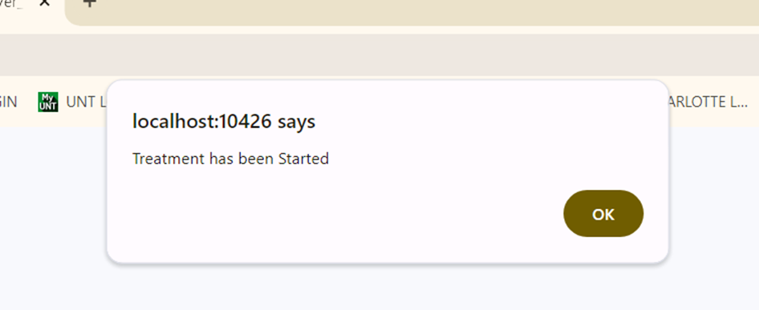
TREATMENT STARTED

Slide 32
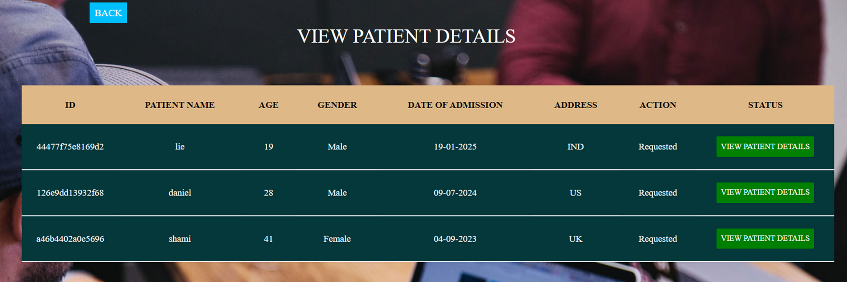
EMR DS APPROVAL

Slide 33
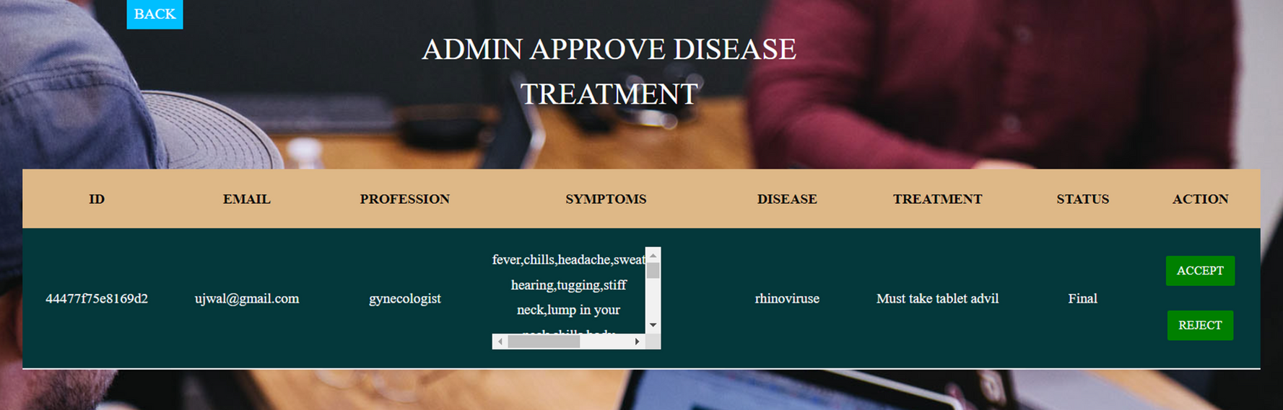
EMR DS FINAL STATUS

Slide 34
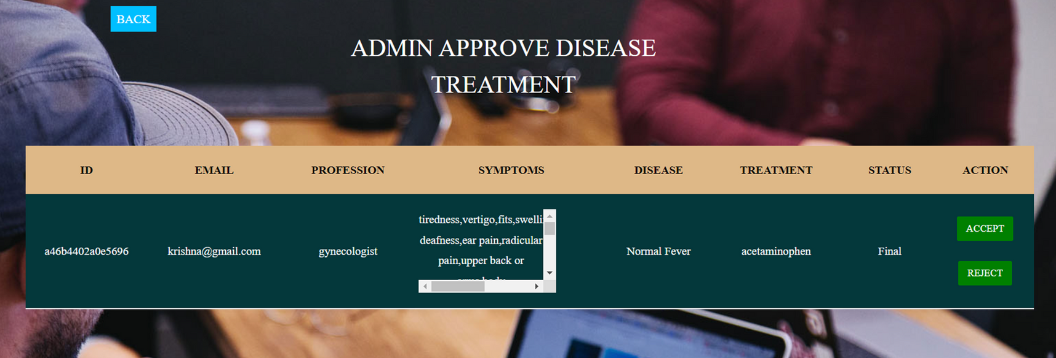

Slide 35
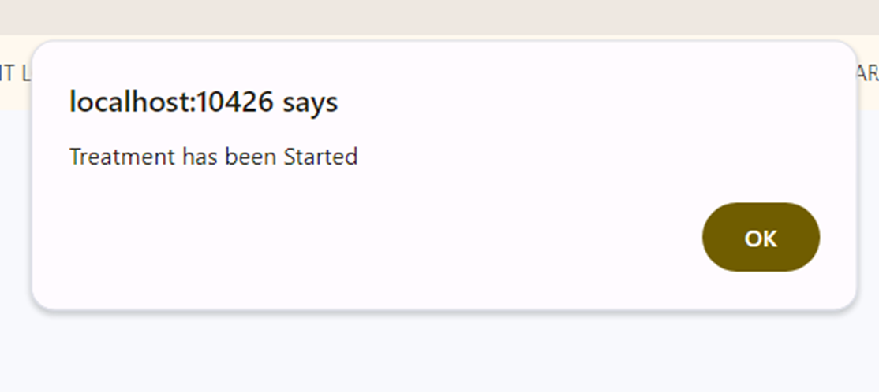
TREATMENT STARTED

Slide 36



Shaik Mohammad Waseem Akram
6281764385
akram.20bcd7141@vitap.c.in

